Slide 1
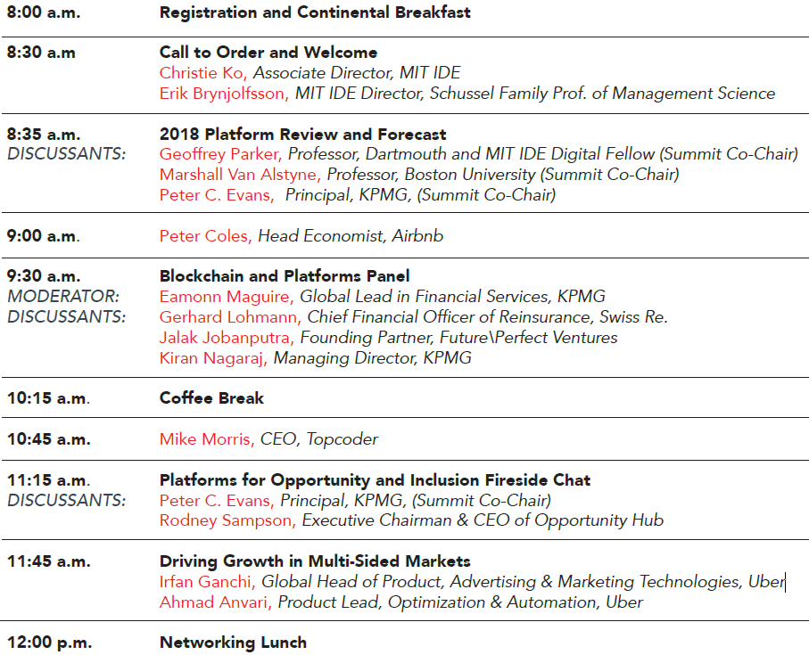
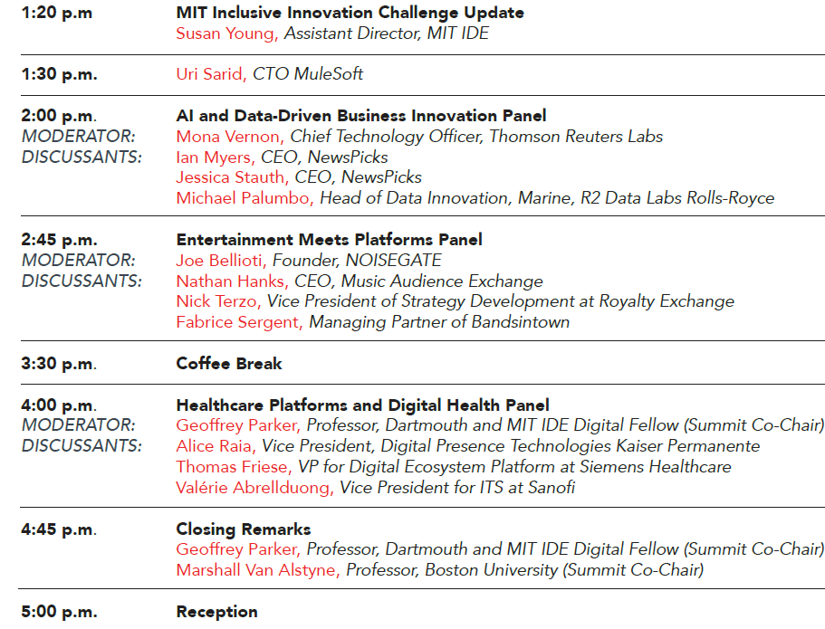
Conference Agenda
Q&A: www.sli.do, Event Code: #B567
Notes:
Since the last IDE Annual Conference, we’ve added the following supporters: IBM Watson, Dell-EMC, Schneider Electric, AI In Gov, Walmart Foundation, Deloitte Digital, Ralph C Wilson Foundation,

