Slide 1
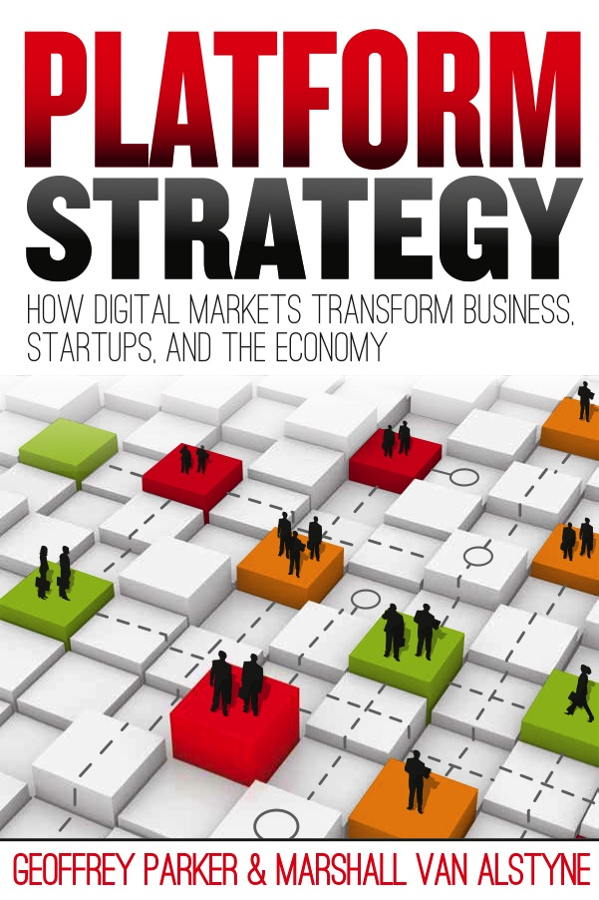

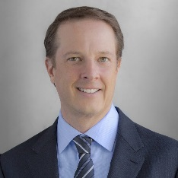
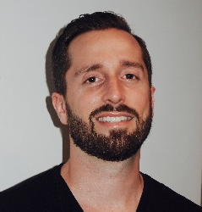
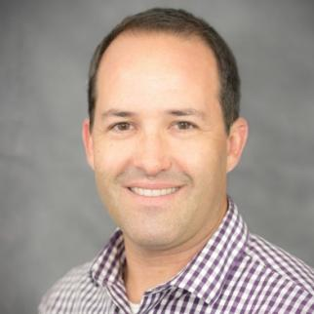
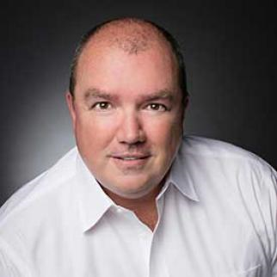
MIT Platform Strategy Summit
July 14, 2017
MIT Media Lab
Platforms and Payments
Platforms and Payments
http://ide.mit.edu/events/2017-platform-strategy-summit
Peter C. Evans
Principal, Innovation & Enterprise Solutions
KPMG
Chair
Jeremy Neren
Founder and CEO
GrocerKey
Drew Weinstein
Co-founder and President
Velo Payments
Frank Young
Senior Vice President
Global Payments

Slide 2
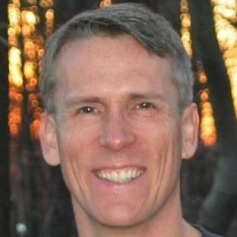
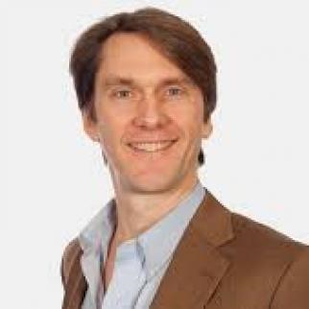
MIT Platform Strategy Summit
The Platform Year in Review and New Themes
July 14, 2017
MIT Media Lab
Platforms and Payments
http://ide.mit.edu/events/2017-platform-strategy-summit
Summit Chairs
Geoffrey Parker
Professor and MIT Visiting Scholar
Dartmouth
Peter C. Evans
Principal, Innovation & Enterprise Solutions
KPMG
Marshall Van Alstyne
Professor and Chair of Information Systems
Boston University

Slide 3
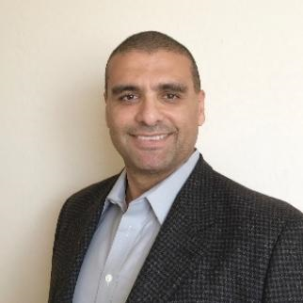
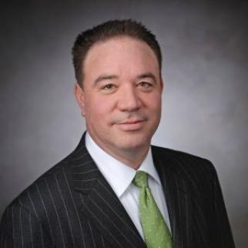
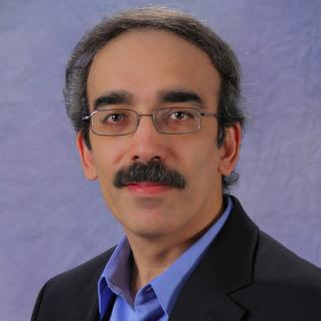
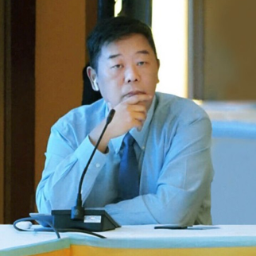
MIT Platform Strategy Summit
July 14, 2017
MIT Media Lab
Platforms and Payments
AI and Machine Learning in Platforms
http://ide.mit.edu/events/2017-platform-strategy-summit
Marshall Van Alstyne
Professor and Chair of Information Systems
Boston University
Chair
Walid Ali
Senior Director, AI & Cloud Solutions
Intel Corp.
Steve Hill
Global Head of Innovation and Investment
KPMG
Ruchir Puri
Chief Architect
IBM Watson
Xiangyu Wang
VP, Enterprise Products
Tencent

Slide 4
MIT Platform Strategy Summit
Smart Connected Devices and the Internet of Things
http://platforms.mit.edu
July 14, 2017, MIT Media Lab
Platforms and Payments
Geoffrey Parker
Professor & Research Fellow
Dartmouth & MIT
Chair
Carsten Becker
Head of Corporate Center Innovation
TÜV NORD Industry Services
Lilian Coral
Chief Data Officer
City of Los Angeles
Chetan Desai
Global Industrial Internet Manager
Schlumberger
Susanne Seitinger
Global Lead for Smart Cities
Philips Lighting
Geoff Snelson
Director of Strategy and Futures
Milton Keynes Council

Slide 5
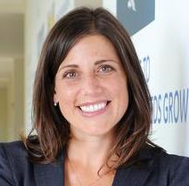
MIT Platform Strategy Summit
July 14, 2017
MIT Media Lab
Digital Industrial Platforms: Integrating Edge, Cloud, Apps
Platforms and Payments
“EU Single Digital Market Initiative”
http://ide.mit.edu/events/2017-platform-strategy-summit
Danielle Merfeld is Vice President at GE Global Research, reporting to the Senior Vice President and Chief Technology Officer of GE. In this role, she leads the Silicon Carbide and Edge Controls horizontal breakout teams, which are focused on delivering critical achievements in SiC devices & systems and developing critical edge product applications and platforms, respectively.
Danielle Merfeld
VP, GE Global Research

