Slide 1

MIT Initiative on the Digital Economy 2017
Platform Year in Review and New Themes
Geoffrey Parker
Peter C. Evans
Marshall Van Alstyne

Slide 2
PLATFORM STRATEGY SUMMIT AGENDA
1

Slide 3
New emerging themes
Platform globalization
Platform consolidation
Greater platform regulation
Platforms go industrial
Competition for developer talent
Platforms – drivers of innovation
2

Slide 4
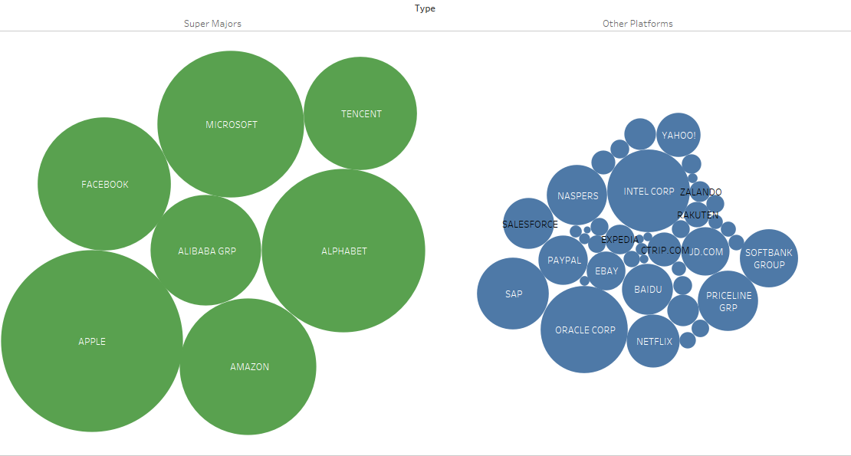
World’s top 50 public platforms by market cap
Supermajors and the rest
Supermajor Platforms
7 companies = $3.5 trillion
Other Platforms
43 companies = $1.4 trillion
Source: Data from Thomson Reuters Eikon, May 2017
3

Slide 5
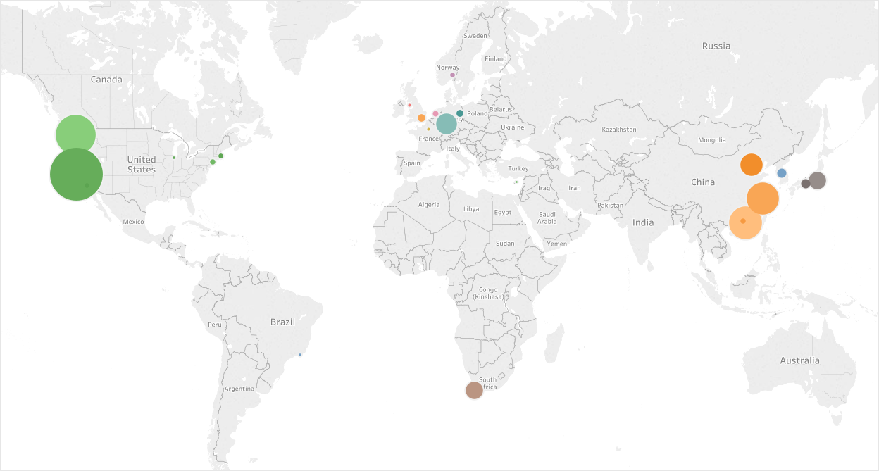
Global platform landscape, Top 50 distribution
Europe
3.7%
S. Korea
0.5%
United States
75%
China
16%
Japan
2.6%
L. America
0.1%
Africa 1.8%
Source: Data from Thomson Reuters Eikon, May 2017
4

Slide 6
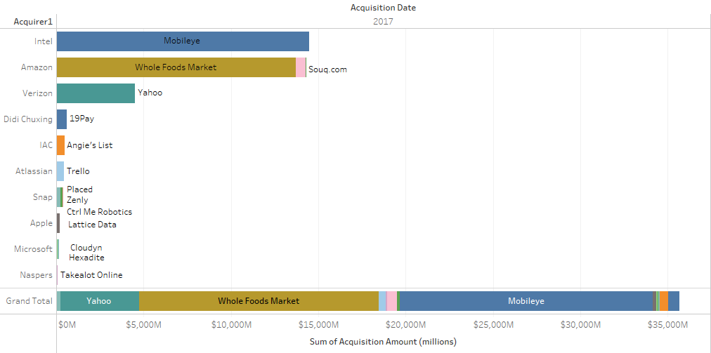
Platform M&A Activity, 2017 (year to date)- $36 billion
5

Slide 7
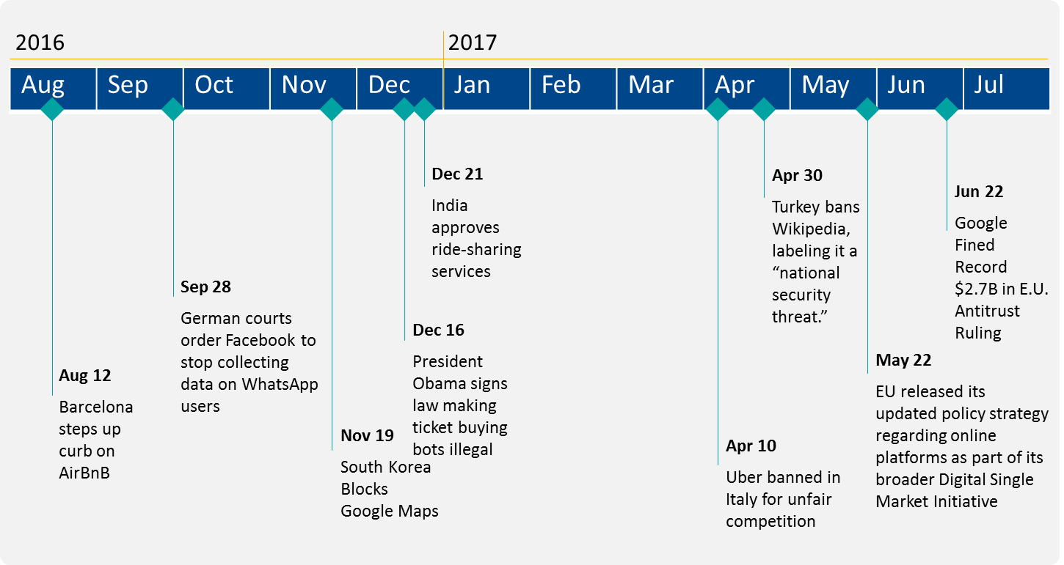
Shifting regulatory landscape for platforms
Source: various news sources, 2016-2017

Slide 8
EU General Data Protection Regulation (GDPR)
GDPR will apply from May 25, 2018
Expanded scope: GDPR regulation includes “processors” and “controllers” of data; institutions must own their compliance as well as third-party companies.
Significant fines: non-compliance can incur a fine of either 4 percent of a company's annual global revenue or €20 million, whichever is greater.
Increased consumer rights: GDPR has expanded the scope of rights for data subjects, including data portability and access.
Data breach reporting: notification of a data breach is now required within 72 hours.
Data protection officers: institutions may be required to appoint data protection officers to monitor compliance with GDPR regulation.
7
Notes:
See, https://www.financierworldwide.com/financial-institutions-and-the-general-data-protection-regulation/#.WSMfL_krKUl.
See, https://www.slaughterandmay.com/media/2535649/the-general-data-protection-regulation-what-financial-institutions-need-to-know.pdf

Slide 9
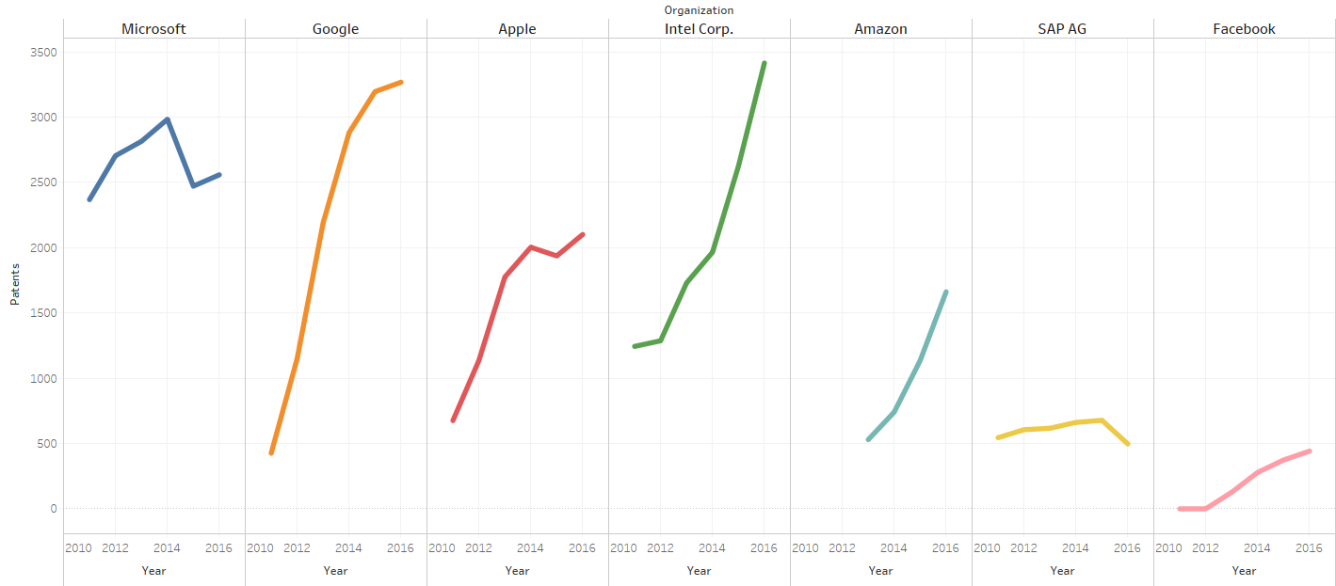
Innovation- platforms show strong patent growth
Source: Top 300 Patent Owners, Intellectual Property Owners Association, 2011, 2012, 2013, 2014, 2015, 2016
8

Slide 10
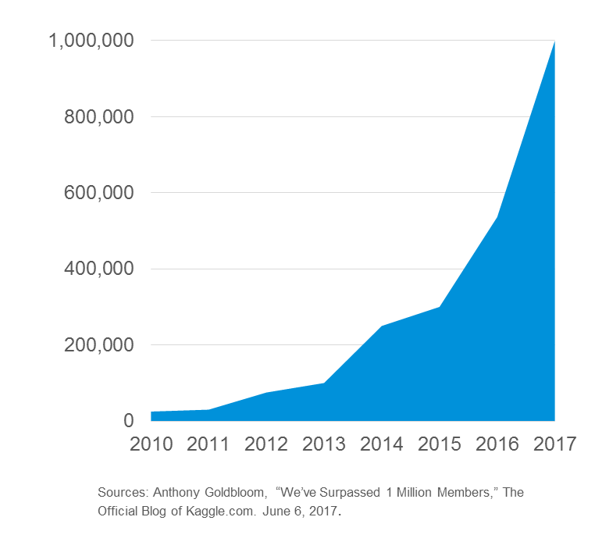


Expert networks, developers and the race for talent
Machine Learning/ Analytics Platform
Kaggle Hits 1 million members
Developer conferences proliferate
9

Slide 11
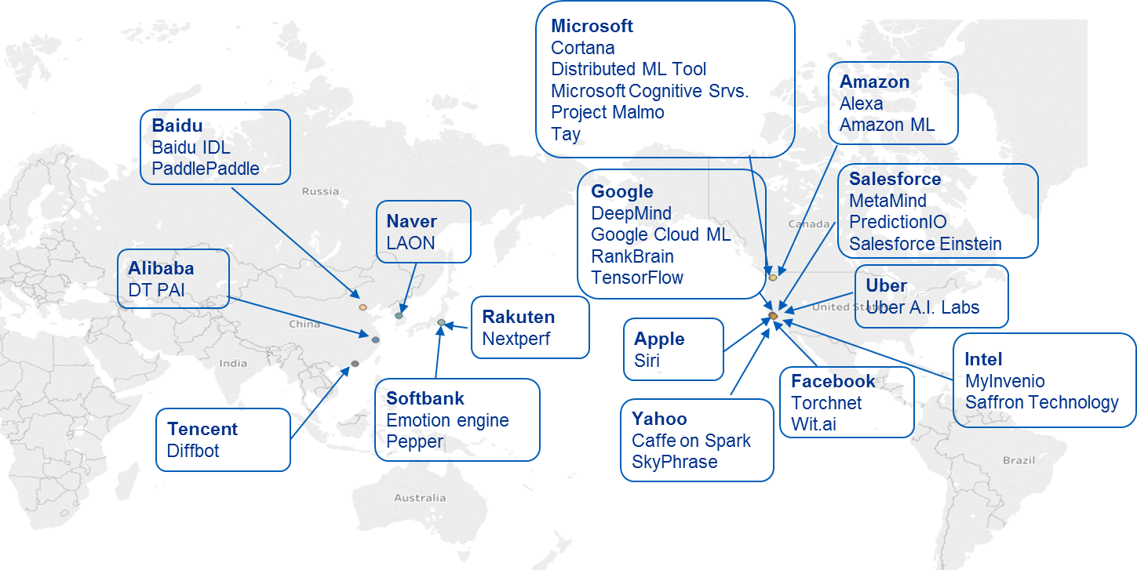
Platform Company AI programs
Source: various news sources, 2016-2017
10

Slide 12
Key themes for today…
Role of platforms in national systems of innovation
Variation in global distribution of platform growth
Platform strategy– design, M&A, globalization
Next wave-- growing marriage of AI and platforms

Slide 13

Contact
ide.mit.edu

